Slide 1
Smart Surveillance System using Computer Vision

Slide 2
#Team:
Amit Sati
(Testing, Documentation)
Deepankar Sharma
(Coding-Python, CV)
Pawan Chandra
(Documentation , Presentation )

Slide 3
# Proposal:
The basic idea is to make Surveillance system “smart” by applying the Computer Vision Techniques to automatically generate alerts in case of mishaps like burglary so that one doesn’t need to physically monitor the cam feeds.

Slide 4
# Technology:
Python (Coding)
OpenCV (Computer Vision)
Firebase (Realtime feed to user)
Twilio API (Alerts)

Slide 5

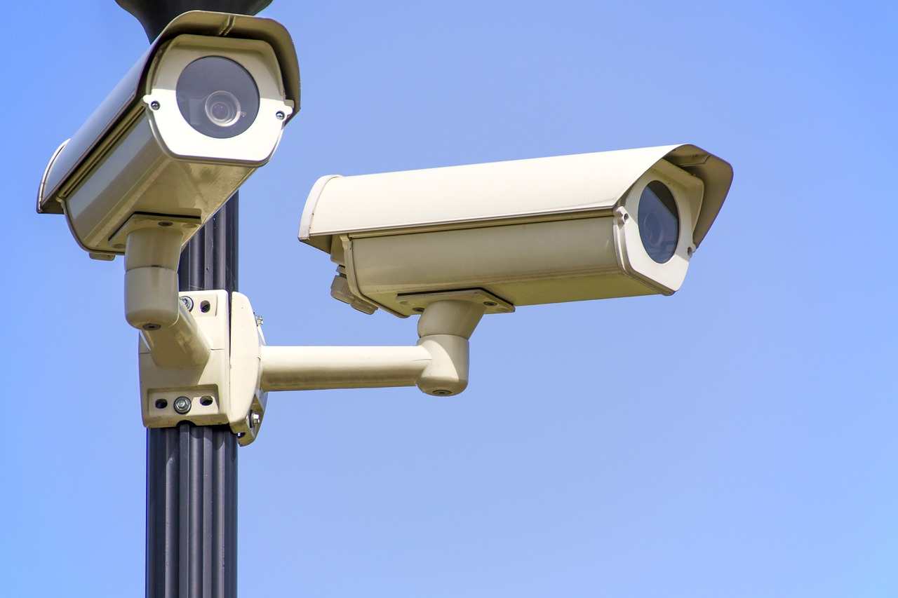

# Overview:
Here our model will do some processing !!!!!
Bro , there’s theif in the house !!!!

Slide 6
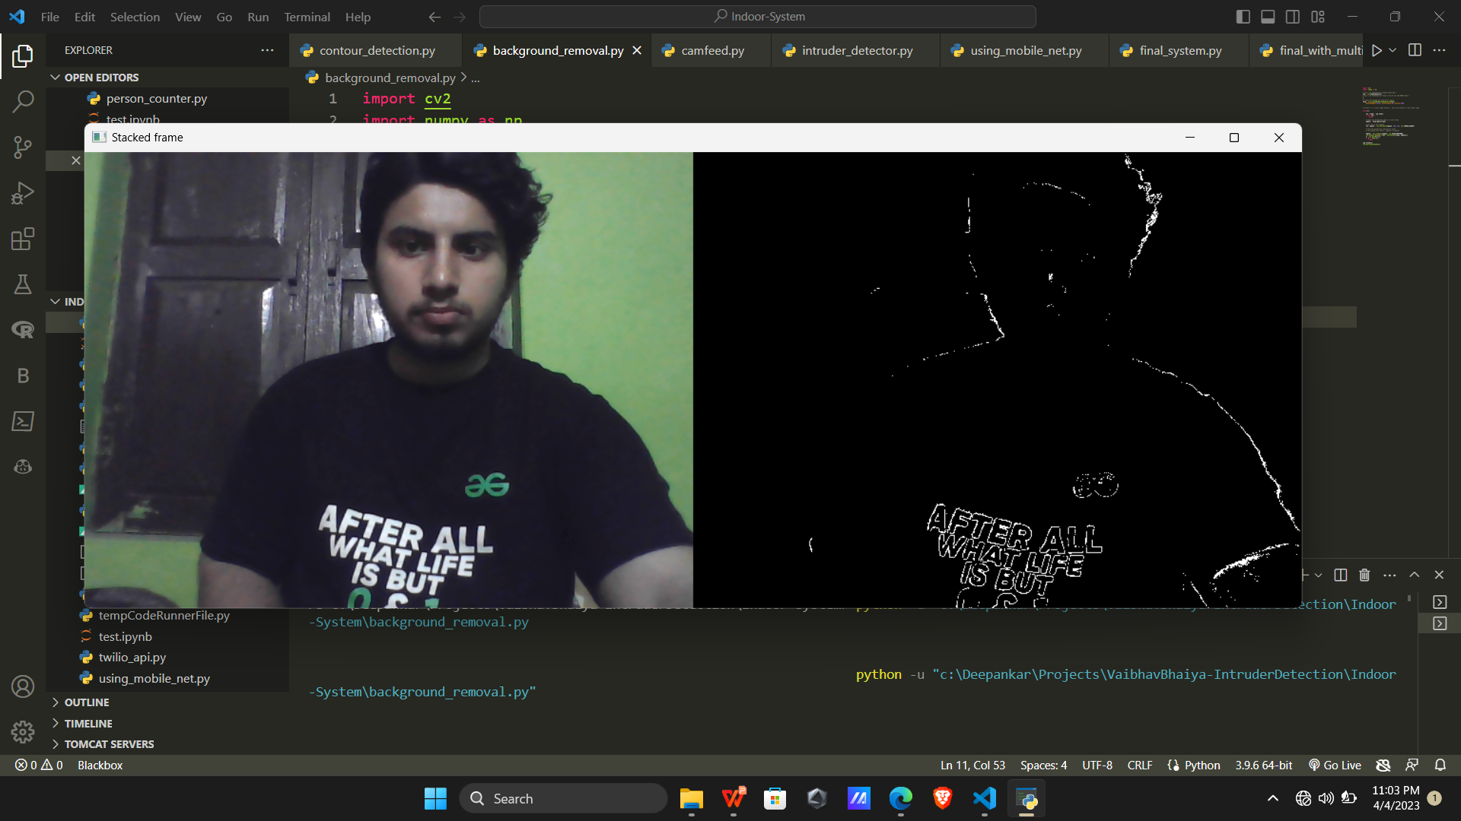
# Progress: Motion Detection via Background Subtraction

Slide 7
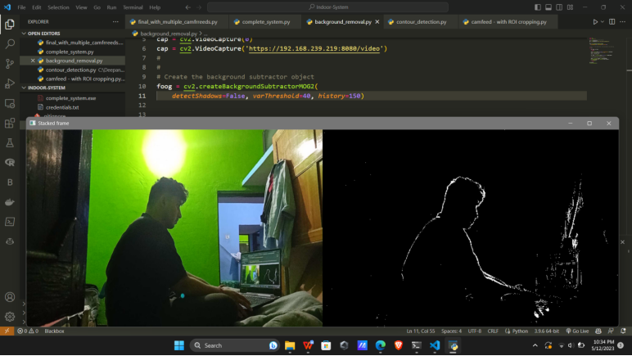
# Progress: Dilation

Slide 8
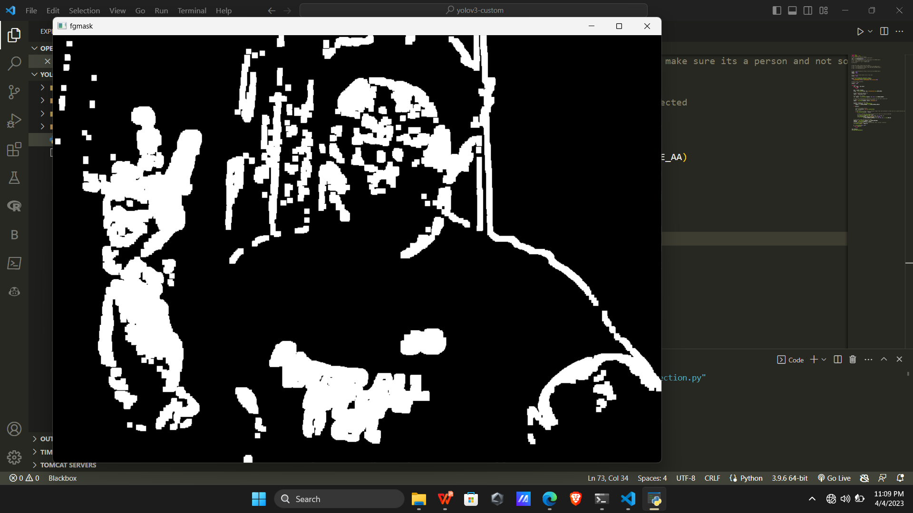
# Progress: Countour Plotting

Slide 9
Computational Efficiency Faster Processing Effective at a certain height, when people are of size of contours
Why Contours......

Slide 10
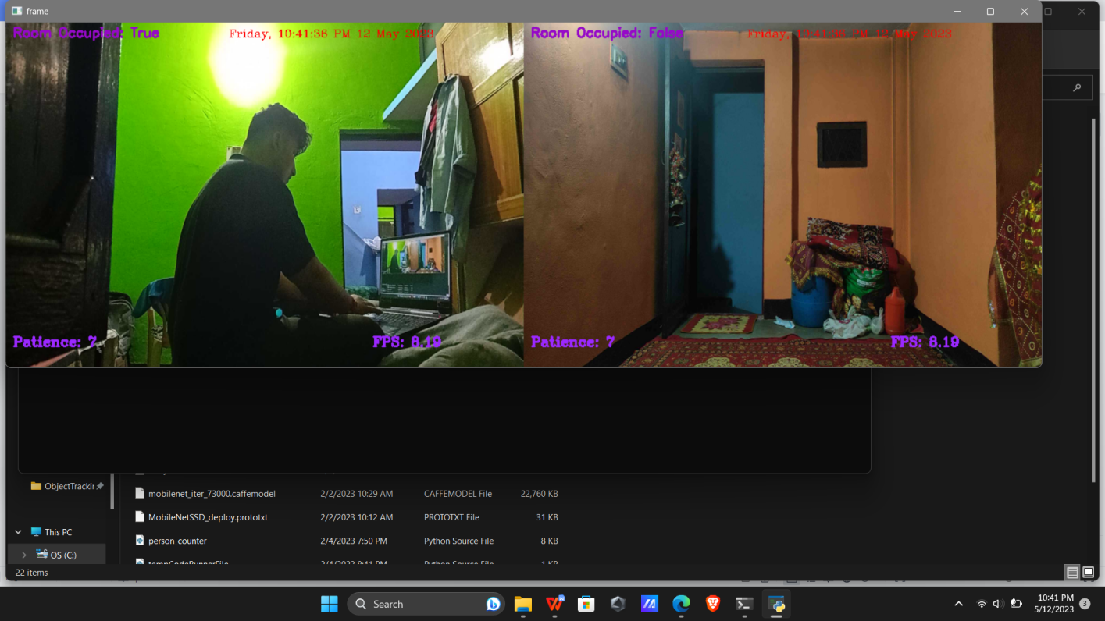
# Progress: Complete Integration

Slide 11
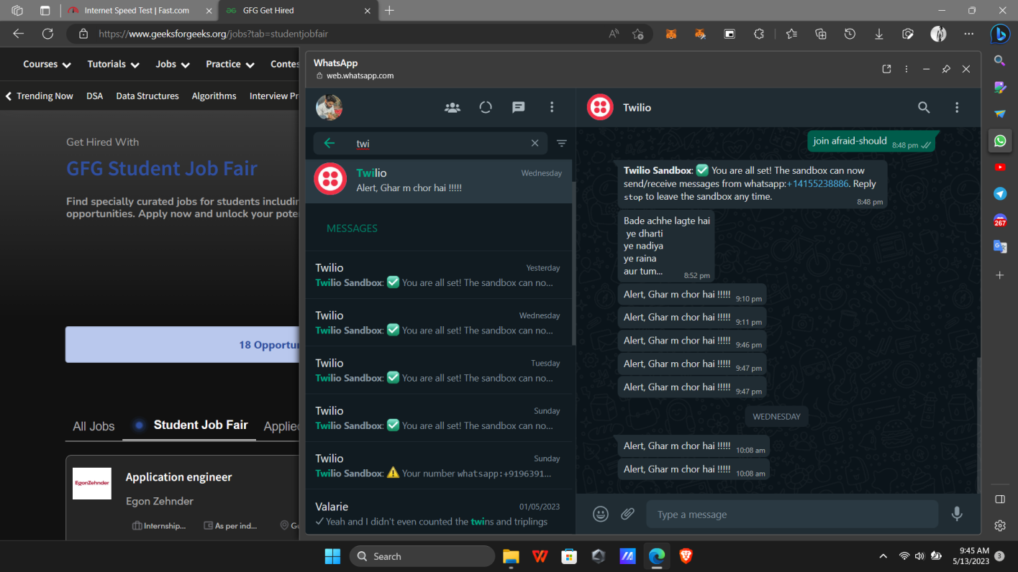
# Progress: Alert Generation

Slide 12
Further Advancements: Pipelined yolo v3 people tracking
Only Motion Detection?

Slide 13
YOLOv3 on realtime feed

Slide 14
Thank You !!

